Slide 1

Innovative Project CN 2022
Submitted By-
Ajay Kumar Dhurwe
2K19/SE/004
Submitted To -
Prof. Divyashikha Sethia

Slide 2

PROBLEM STATEMENT
Using Socket programming we had to implement a secure multi client support day time server that can allow clients to seek the current day and time from the server.This was to be done using unix network socket programming and open SSL for AES encryption.
WHAT TO EXPECT :
Our secure multi client support day time server that can allow clients to seek the current day and time from the server.

Slide 3
What is socket programming
Socket programming is a way of connecting two nodes on a network to communicate with each other. One socket(node) listens on a particular port at an IP, while other socket reaches out to the other to form a connection. Server forms the listener socket while client reaches out to the server.

Slide 4
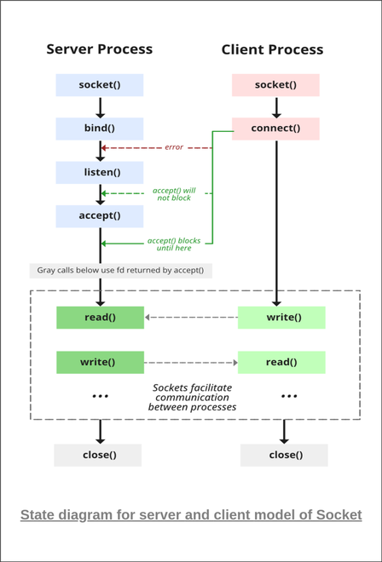
What is socket programming

Slide 5
Encryption and Decryption
Encryption is the process of converting normal message (plaintext) into meaningless message (Ciphertext).
Decryption is the process of converting meaningless message (Ciphertext) into its original form (Plaintext).

Slide 6
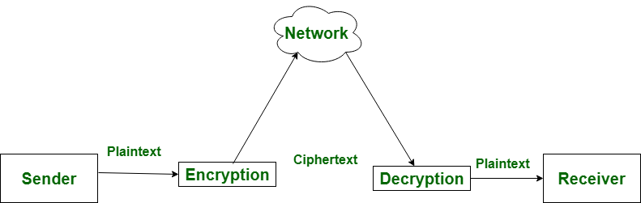
Encryption and Decryption

Slide 7
Advanced Encryption Standard (AES)
In this program I have also used AES library (Advanced Encryption Standard) AES is a cipher block algorithm that specification for the encryption of electronic data established by the
U.S National Institute of Standards and Technology (NIST) in 2001. AES is widely used today as it is a much stronger than DES and triple DES despite being harder to implement.

Slide 8
What is SSL ?
An SSL certificate is a digital certificate that authenticates a website's identity and enables an encrypted connection. SSL stands for Secure Sockets Layer, a security protocol that creates an encrypted link between a web server and a web browser. It uses encryption algorithms to scramble data in transit, which prevents hackers from reading it as it is sent over the connection. It's a protocol for servers and web browsers that makes sure that data passed between the two are private.

Slide 9
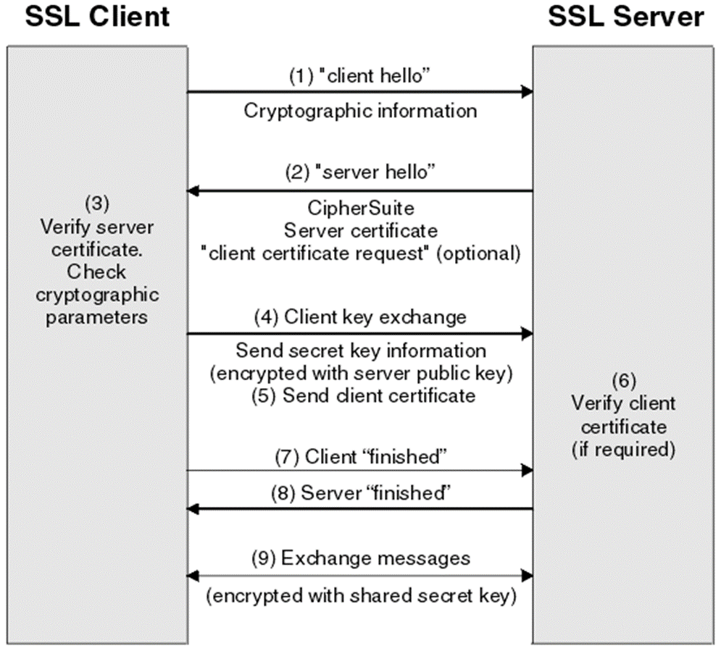
What is SSL ?
SSL is a cryptographic protocol which defines how two entities securely communicate with each other. Secure Socket Layer (SSL) also known as Transport LayerSecurity (TLS) is often referred to as “SSL” SSL Handshake.

Slide 10

Thank you !

